Slide 1
Modeling Attenuation of Solar Energy Through a Tree
Aysha Rahman
Notes:
Hello, everyone. My name is Aysha Rahman, and I’m a junior astrophysics major here at Agnes Scott College.
Today, I’ll be talking to you about my project in which I attempted to model the attenuation of solar energy through a tree. Spoiler alert: I did not actually get to do this because, as it turns out, creating a tree in the first place is kind of difficult. That’s okay, though. Science is as much about failures as it is successes, so I’ll walk you through my process and what I’ve learned, and I’ll discuss what needs to be done in the future.

Slide 2
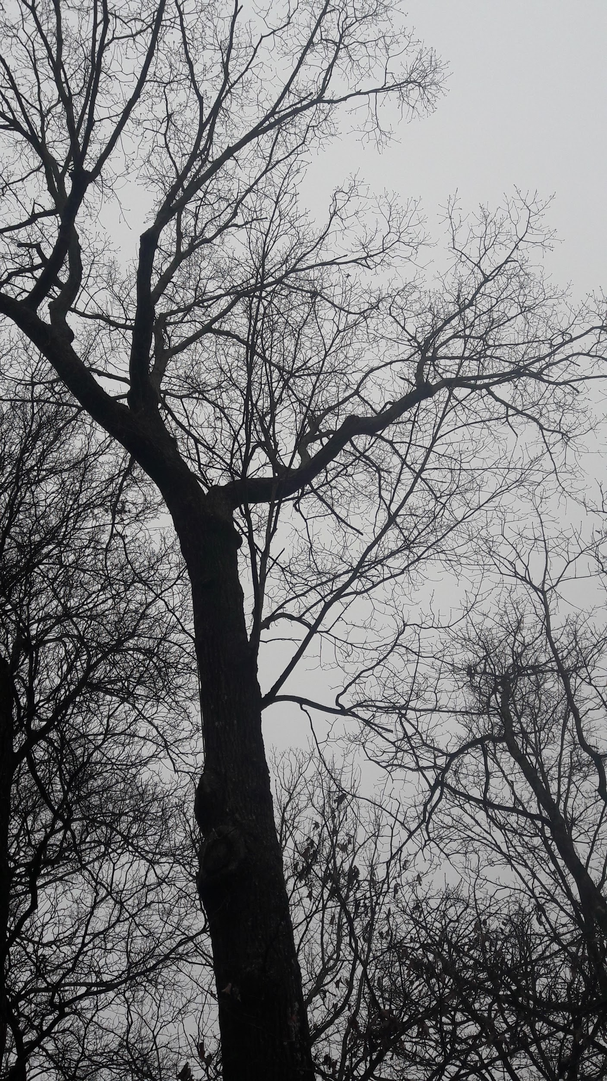
The Issue
Tree blocking observatory solar panels
Dormant tree blocks lots of sunlight, but how much?
Notes:
So, as an astrophysics major, I’ve taken my fair share of classes at the observatory. One thing to note about the observatory is that there are solar panels on the roof of the obs, which you can see if you ever go up there. Another thing to note is that the area is surrounded by trees. For the most part, this isn’t too much of an issue, but there is one tree in particular that blocks some of the solar panels. Obviously, when the tree is in full foliage in the warm months, it blocks a lot of light, but it still does so a surprising amount even in the dead of winter when the tree is essentially just a large network of twigs in the air. So, this begged the question: How much light does a dormant tree block, and how would it affect the output of solar panels in its way?

Slide 3
Creating a Tree
Assumptions
Coordinate systems
Generating branches
Rotating branches
Notes:
I wanted to address this by creating a Monte Carlo simulation of light passing through a randomly generated dormant tree. To do that, I had to first create a tree. This was tricky, and as of yet I have not been successful, but I’ll walk you through my process and a bit of the code.
First, we’ll talk about some assumptions we made going into this project. Then, we’ll talk about generating tree branches, and then we’ll talk about lining them up in the appropriate coordinate system to get our 3 dimensional tree.

Slide 4
Assumptions
Branches in 2 each time
No more than 90 degrees
Branches 10 times
Total thickness of tree constant
Length of branches gets smaller
Notes:
Here are some of the initial assumptions and observations we made. First, we said that each branch splits into two each time, which is a pretty reasonable assumption by observation. We also said that when the split occurs, the two new branches are no more than 90 degrees apart from one another. We’ll talk more about angles later.
Another assumption we made is that the tree branches 10 times, which is a decision we came to by observation; 10 is a pretty reasonable number. Just by looking at this particular tree, which is, by the way, the tree in question blocking the solar panels, some of the branches split 7 times, some split 11, and others split similar numbers of times.
Another pretty obvious-by-observation assumption we made was that the length of each of the new branches is shorter than the length of the previous one.
The final assumption we made before we began was that the total thickness of the tree would be constant; this is apparently called Leonardo’s rule, as Leonardo da Vinci made this observation which seems to hold true. If you take a tree and collumate it into a cylindrical shape, the thickness of the trunk should be roughly the same as the thickness near the top of the tree.

Slide 5
Coordinate Systems
Global coordinate system:
Local coordinate system
Rotation
double xg[MAXPTS], yg[MAXPTS], zg[MAXPTS];
double xl[MAXLOCAL], yl[MAXLOCAL], zl[MAXLOCAL];
Notes:
We use two different kinds of coordinate systems here: a global one and a local one. We think of our global coordinate system being a cube, a 3-dimensional grid with the points where the tree exists filled in. We can say the “lines” of the grid use a step size that we’ll define in the code, which we choose to be as small as the computer can handle. The global coordinate system has its origin at the base of the tree. The point where the trunk splits is 0,0,L0, with L0 being the length of the trunk.
Each branch has its own local coordinate system. This is used to generate the new branches, and the origin is located at wherever the parent branch splits into two, with the z axis being along the parent branch.
In order for the new branches to be useful, they must be converted back into the global coordinate system. We use a rotation matrix to do this, which we’ll discuss later.

Slide 6
Generating Branches
L_{n} = L_{n-1}*r_{L}
T_{n,left} = T_{n-1}*r_{T}
T_{n,right} = T_{n-1}(1-r_{T})
0 < 𝜃 < 𝜋/2
𝜃_{left} = 𝜃_{right}
0 < 𝜑 < 2𝜋
𝜑_{left} = 𝜑_{right} - 𝜋
Vertical angle 𝜃
Length
Horizontal angle 𝝋
Thickness
Notes:
To create the tree, we considered four variables: the length of each branch, its thickness, its horizontal or azimuthal angle phi, and its vertical angle theta.
Let’s consider r to be a random number between 0 and 1, and L to be the length of a branch, the thickness t, the horizontal angle phi, and the vertical angle theta. Then we’ll generate each property by these rules:
For each new branch, its length is equal to the length of the previous branch times the random number between zero and one.
For the thickness, we consider the thickness of a left branch vs the thickness of a right branch. Which branch is right or left is, of course, completely arbitrary.
For the vertical angle theta, which comes down from the z axis onto the x-y plane, we say it’s between zero and pi/2. We assume that the branch splits symmetrically along its own axis and say that the theta for the left and the right are the same.
For the azimuthal angle phi, which rotates the new branches along the x-y plane, we say that it’s between 0 and 2pi. We assume that the branches split along this angle exactly opposite each other, so we say the left phi is equal to the right phi minus pi.

Slide 7
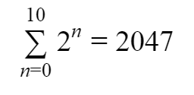
Generating Branches
double x0[2047], y0[2047], z0[2047], L[2047], thickness[2047];
2^{n} top branches
Notes:
As I mentioned earlier while talking about coordinate systems, the tree is a collection of points inside a 3-dimensional grid. These points are stored in the code as arrays, with one each for the x, y, z coordinates as well as one for length and one for thickness. Each array has 2047 points, where we store the beginning and endpoints of each branch. This number comes from the number of tree branches. We said there were 10 iterations and 2 new branches at every split, so total number of branches is the sum from 0 to 10 of 2 to the n.

Slide 8
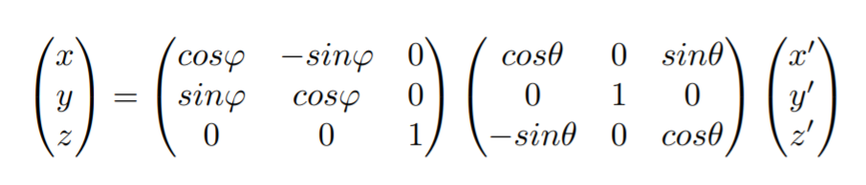
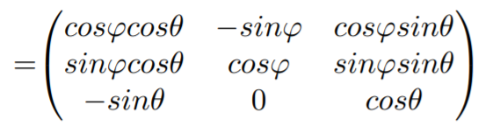
Rotation
Notes:
This is the rotation matrix we used to transform the local coordinates into global coordinates. I don’t have too much to say about these, and they’ll be shown in the code later on, but this matrix gives rotation along two axes, which is what we need since we have two angles, theta and phi.

Slide 9
Code
int main(int argc, char *argv[])
{
double tpi = 6.283185308;
double pi = 3.141592654;
int i,j,k=0,m,n,p,q,t=0,s,l=0,Nlocal, Lsteps, rsteps;
int MAXPTS=64000,MAXLOCAL=1000;
FILE *outf;
double stepsize=0.1, L0=10.0, r1, r2,r3,r4,t0=1;
double A00, A01, A02, A10, A11, A12, A20, A21, A22;
double x0[2047], y0[2047], z0[2047], L[2047], thickness[2047];
double cost[2047],sint[2047],phi[2047],cosp[2047],sinp[2047];
double xg[MAXPTS], yg[MAXPTS], zg[MAXPTS];
double xl[MAXLOCAL], yl[MAXLOCAL], zl[MAXLOCAL];
char outfile[128];
/* initialize */
srand(time((time_t*)NULL));
for(i=0; i<2048; i++)
{
L[i] = 0.0;
thickness[i] = 0.0;
x0[i] = 0.0;
y0[i] = 0.0;
z0[i] = 0.0;
}
for(i=0; i<MAXPTS; i++)
{
xg[i] = -1.0;
yg[i] = -1.0;
zg[i] = -1.0;
}
L[0] = L0; /*could be user-specified*/
Notes:
Now let’s look at the code we have. This slide isn’t much, it’s just introducing/initializing all the variables we’ll be using. We have pi, we have some integers, we have possible points in our grid in MXPTS and MAXLOCAL, we have step size, an initial length for the tree trunk, some random numbers, an initial thickness, the A00-A22 which is our rotation matrix. Next we have several arrays; these are the arrays that store the starting and ending points. And then we have our global and local coordinates. One thing to note is that there are a lot of big numbers here. The MAXPTS and MAXLOCAL were much larger numbers--MAXPTS was 64 billion and MAXLOCAL was 10 million; they’re the possible points in this large grid, after all, and we wanted to have a reasonably small step size. However, the computer wouldn’t compile the code when the numbers were so big, so that is an issue we have to resolve.
Here, we’ve initialized some variables.

Slide 10
Code
thickness[0] = t0;
k=1;
while(k < 2048)
{
/* generate a new branch */
/* branch length */
r1 = 1.0*rand()/RAND_MAX;
L[k]=fabs(L[k-1]*r1);
L[k+1] = L[k];
r2 = 1.0*rand()/RAND_MAX;
thickness[k]=fabs(thickness[k-1]*r2);
thickness[k+1] = thickness[k-1]*(1-r2);
Lsteps = L[k]/stepsize+1;
rsteps = thickness[k]/stepsize+1;
for(m=0;m<rsteps;m++)
{
for(p=0;p<rsteps;p++)
{
for(q=0;q<Lsteps;q++)
{
xl[l] = -thickness[k]+m*stepsize;
yl[l] = -thickness[k]+p*stepsize;
zl[l] = q*stepsize;
l++;
}}}
Nlocal = Lsteps*rsteps*rsteps +1;
Notes:
Here is where we generate our branches. First, we have a random number between zero and one, and then we have our branch length, which is the length of the previous branch times the random number r1. Next, we have the branch thickness. We generate a new random number r2, and have one branch be the thickness of the parent branch times the random number r2. The other branch is the thickness of that parent branch times 1 minus the same r2.

Slide 11
Code
/* compute branch direction */
r3 = 1.0*rand()/RAND_MAX;
/* direction cosine of z coordinate 0-pi/2 */
cost[k]=r3;
sint[k]=sqrt(1.0-cost[k]*cost[k]);
cost[k+1] = cost[k];
sint[k+1] = sint[k];
/* one branch is mirror image of the other -- off by pi */
r4 = 1.0*rand()/RAND_MAX;
phi[k]=tpi*r4;
phi[k+1] = phi[k]-pi;
cosp[k] = cos(phi[k]);
sinp[k] = sin(phi[k]);
Notes:
Here is where we generate angles for our branches. We use direction cosines and use our assumptions that thetas are the same for two sister branches and two phis are opposite one another.

Slide 12
Code
/* Rotation matrix */
A00 = cosp[k]*cost[k];
A01 = -sinp[k];
A02 = cosp[k]*sint[k];
A10 = sinp[k]*cost[k];
A11 = cosp[k];
A12 = sinp[k]*sint[k];
A20 = -sint[k];
A21 = 0.0;
A22 = cost[k];
for(l=0;l<Nlocal;l++)
{
xg[t] = A00*xl[l] + A01*yl[l] + A02*zl[l] + x0[k];
yg[t] = A10*xl[l] + A11*yl[l] + A12*zl[l] + y0[k];
zg[t] = A20*xl[l] + A21*yl[l] + A22*zl[l] + z0[k];
t++;
}
x0[k+1] = A02*L[k] + x0[k];
y0[k+1] = A12*L[k] + y0[k];
z0[k+1] = A22*L[k] + z0[k];
k++;
}
}
Notes:
And finally, we have our rotation matrix. This gives us our local tree branch coordinates rotated and translated (note the +x0) into the global coordinate system.

Slide 13
Future Work
Running the code: Make the tree!
Integrating light through the tree

Slide 14
Sources
Eloy, Christophe. "Leonardo’s rule, self-similarity, and wind-induced stresses in trees." Physical review letters 107.25 (2011): 258101.

